Slide 1
Image Caption Generator
Name:Sidhant yadav
Registration Number: 12018419

Slide 2
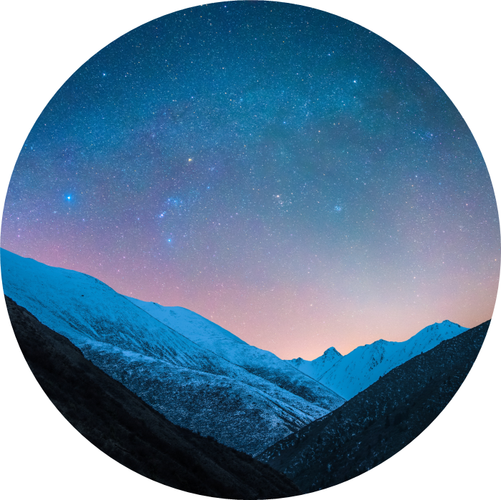
Introduction
“Image Caption Generator”
The target of this project is to build a machine learning algorithm that generates caption for the images we pass as input.

Slide 3
Problem Statement
Whenever we upload an image to any platform we pass a caption with it basically explaining about the image.
Our target was to build an algorithm using Deep Learning technique to generate the caption.

Slide 4
Approach
Our approach was to firstly extract features from the images then extract features from the captions.
Later on we will use certain words for certain features we extracted and generate the captions

Slide 5
Algorithms Used
We have used CNN, LSTM, Embedding layers to build our image and language model to extract features and generate captions.

Slide 6
Model architecture
The model architecture consists of an image model, a language model, and a combination of the two models using concatenation. The image model is a simple feedforward neural network, the language model is an LSTM network with an embedding layer, and the two models are combined using concatenation and fed into two LSTM layers followed by a fully connected layer with a softmax activation function that outputs the predicted probability distribution over the vocabulary for the next word in the caption.

Slide 7
Performance analysis
We have used model accuracy on validation and training set to get the performance analysis of our model

Slide 8



Summary
In summary our project targets to build a machine learning algorithm that can generate captions for picture we pass.

Slide 9




Thank you
Sidhant yadav 12018419

